Slide 1
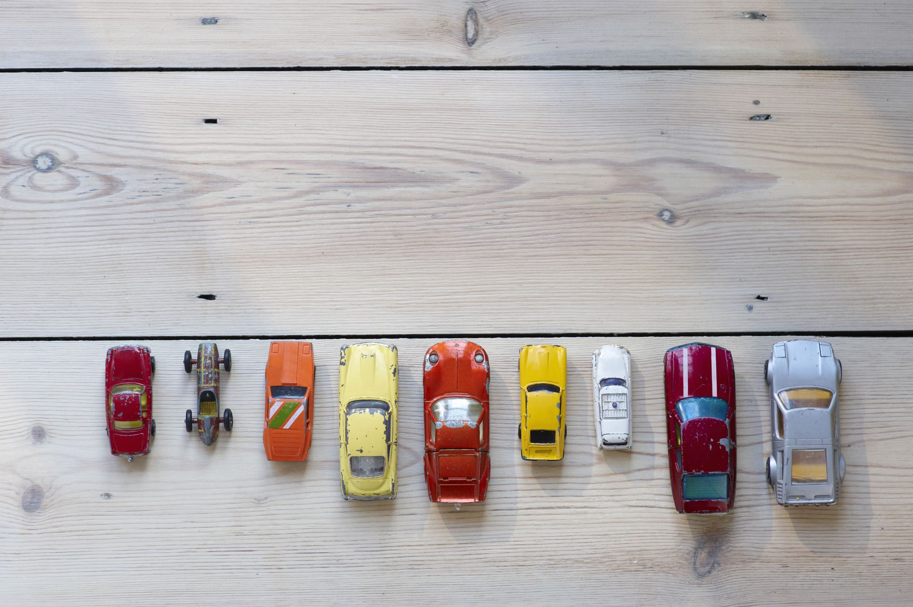
Used Car Price Prediction Report

Slide 2
Acknowledgement
Problem Statement
Data Collection
Data Cleaning
Data Analysis
Preparer a best prediction model

Slide 3
Problem Statement
With the covid 19 impact in the market, we have seen lot of changes in the car market
One of our clients works with small traders, who sell used cars
With the change in market due to covid 19 impact, our client is facing problems with their previous car price valuation machine learning models

Slide 4
Data Collection
In this phase I went to the website of olx.com and started collecting data with the help of selenium library. Here I have collected the data in small parts.
In this data I give relevance to these following features:
Brand, Model, Variant, year, driven Km, fuel type, number of owners, location and price.
I have collected all this data from different areas of Uttar Pradesh.
In this way I collected data of more than 5000 cars.

Slide 5

Data Cleaning
In this phase I created a new file and imported the required libraries first and then I load the data and closely inspect each column
I used these methods over here: Shape, info , unique , is null etc
After this I removed all the mistakes that I see in the data, using drop, replace, astype, isdigit, isnumeric etc

Slide 6
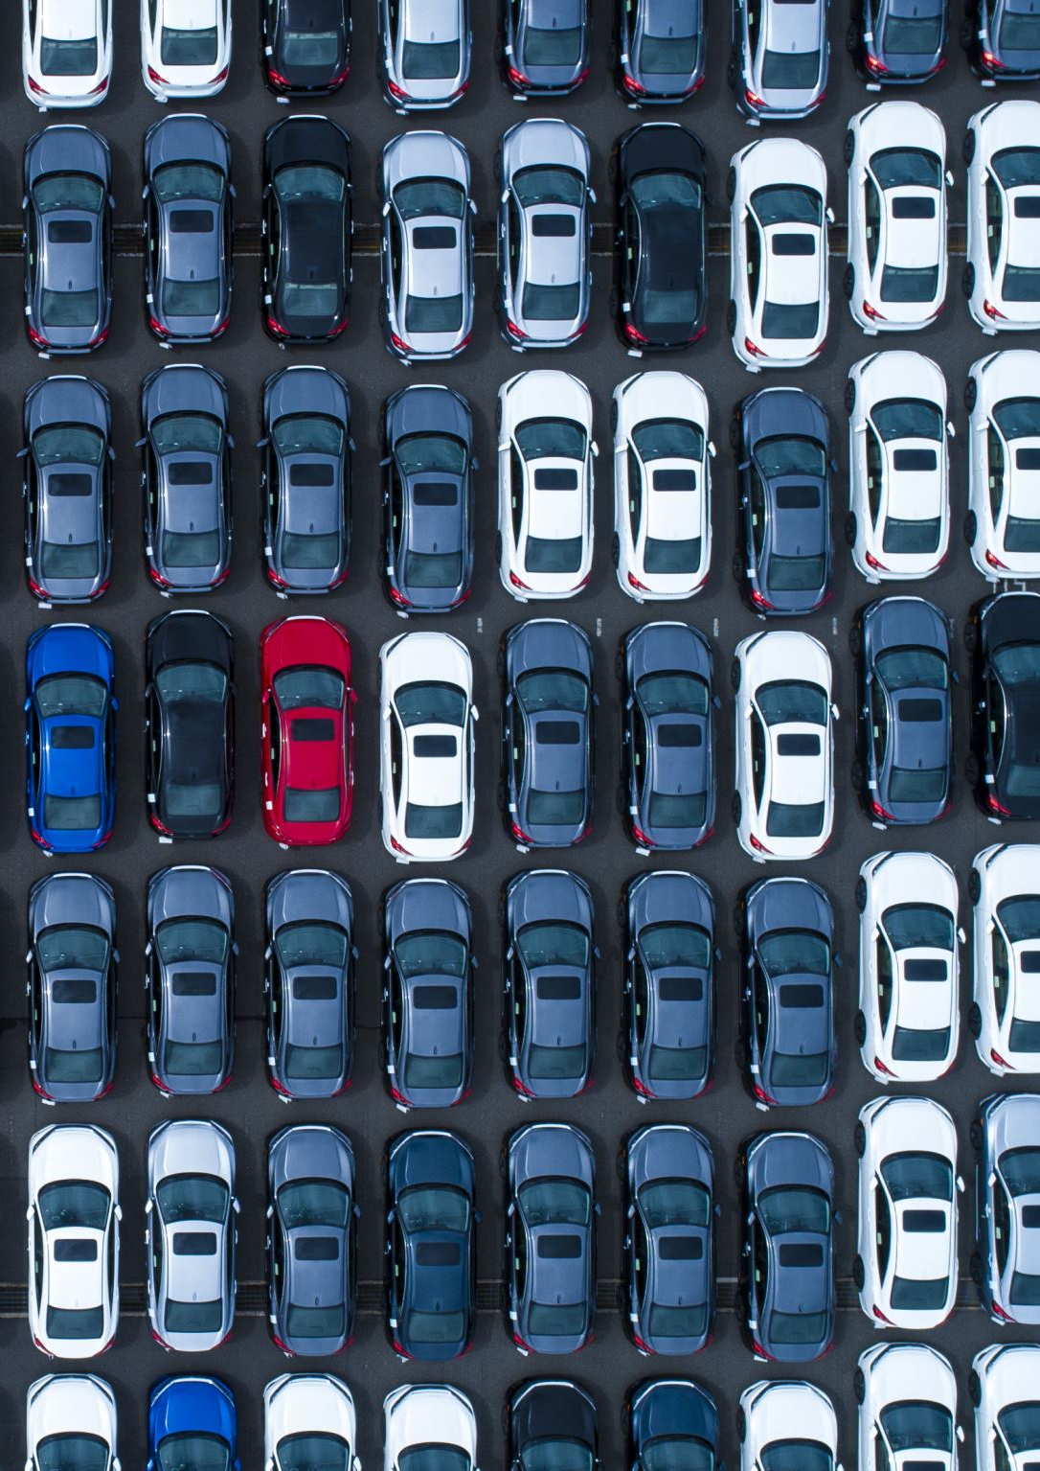
Data Analysis
Name of data Set - car
Rows in data – 5285 (after cleaning)
Columns in data – 7 (after cleaning)
Number of categorical columns – 4
Number of numerical columns – 3
Name of targeted column - “Price”
Problem type – Regression (Supervised ML)

Slide 7
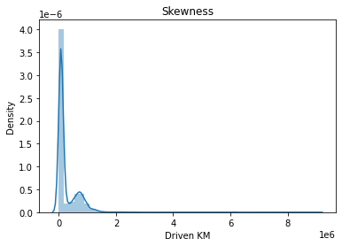
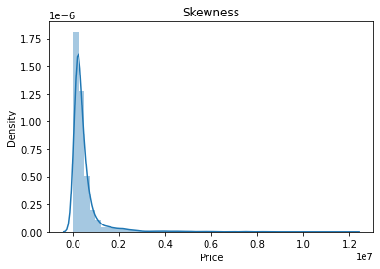
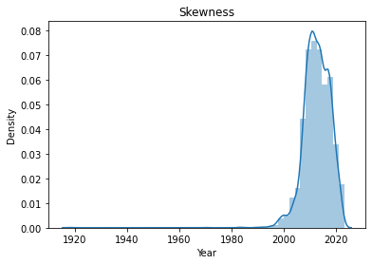
Skewness:

Slide 8
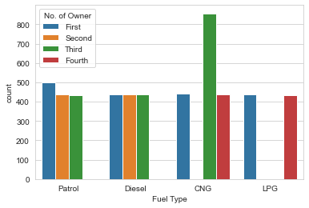
Fuel type vs Owner

Slide 9
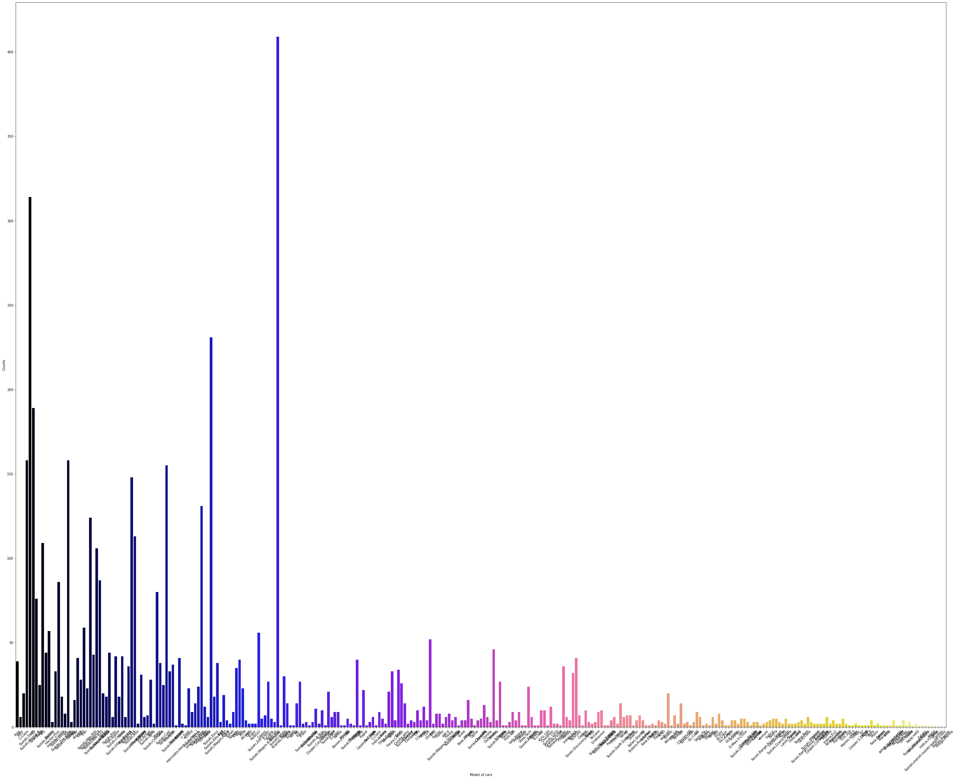
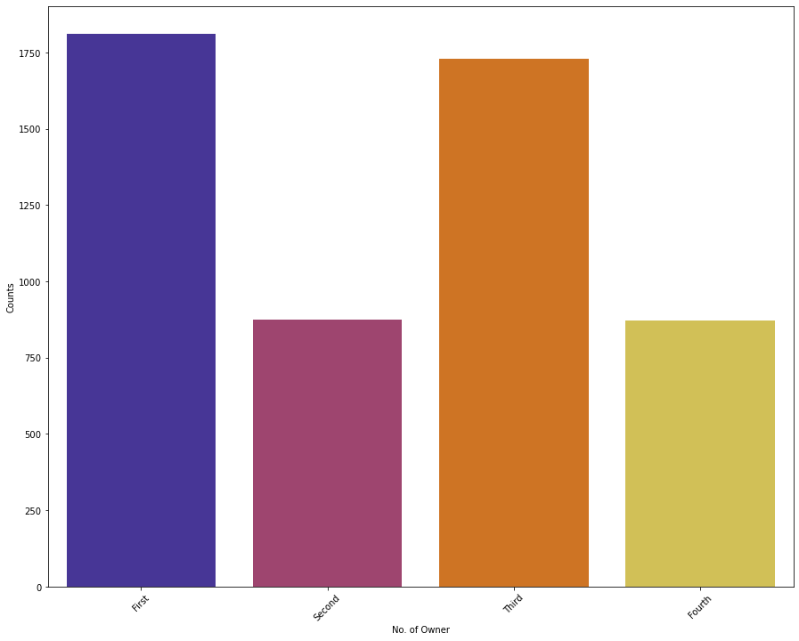
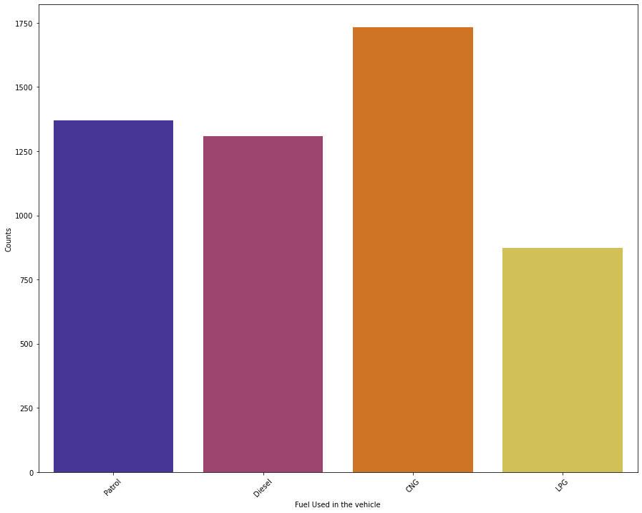
counts of categorical columns

Slide 10
Results of analysis:
Maruti is bestselling car in the market.
The relevance of CNG cars is highest in the market.
Maruti Suzuki Omni, and Maruti Suzuki Wagon-R are Most selling car in the market.
First hand cars are most relevant according to market.
Year column is Left skewed.
Driven Km column is Right Skewed.
Price column is also Right Skewed.
CNG car by Third owner is most selling car.

Slide 11
Preparer a best prediction model
I split the data into two parts x and y, and after this I import required modules for making a good predictor
Finally, 445 random state gave good result, and this is where I saved my model as a predictor using pickle
So, this is the whole journey of this project if you want whole code of this project then follow this GitHub link; Used-Car-Price-Prediction-Project/Used Cars Price Predictions Project.ipynb at main · prashantpathakji/Used-Car-Price-Prediction-Project

